Slide 1
Chapter 10
Emotional Development
Notes:
Add slide notes here

Slide 2
First Emotions and Emotion Regulation (1 of 4)
Izard and colleagues—basic emotions
  Biologically based
  Develop early in life
  Play critical roles in motivating and organizing behavior
Primary emotions
  Distinct basic emotions that emerge within the first 6 months of life
  Birth: Babies show contentment and distress
  Six months: Contentment becomes joy, interest becomes surprise, and distress becomes disgust, sadness, anger, and fear.

Slide 3
First Emotions and Emotion Regulation (2 of 4)
After 18 months:
  Self-conscious emotions emerge
    Require self-awareness
    Embarrassment
    Pride
    Shame
    Guilt

Slide 4
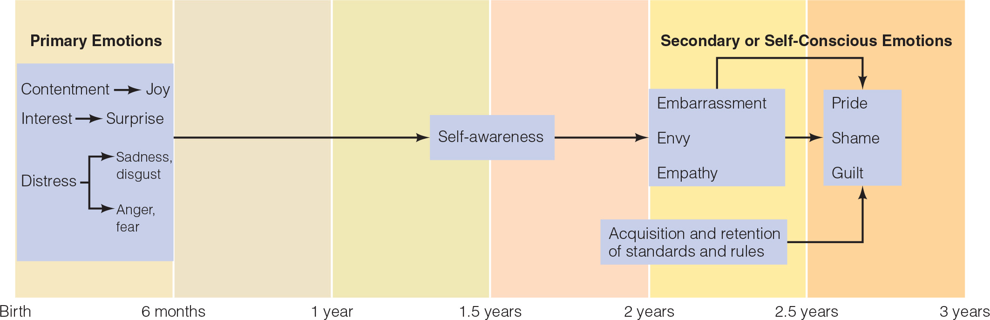

Slide 5
First Emotions and Emotion Regulation (3 of 4)
Infants begin to use social referencing:
  Looking at adults/older children for clues on how to respond to an ambiguous event
  Around 9 months of age:
    Monitor companions’ emotional reactions to stimuli
    Use this information to decide how to feel and behave

Slide 6
First Emotions and Emotion Regulation (4 of 4)
Infants develop strategies for emotion regulation:
  6-month-olds use gaze aversion.
  12-month-olds use self-soothing.
  18-month-olds use distraction and active attempts to change the situation.
Notes:
LO 10-1: Describe emotional development and the role of contextual influences on emotional development in infants and toddlers.
B. Emotion Regulation
a. Emotion regulation: The ability to regulate emotional states and responses
b. 6-month-olds use gaze aversion while 12-month-olds use self-soothing
c. 18-month-olds use distraction and active attempts to change the situation

Slide 7
Emotional Development in Infancy and Toddlerhood (1 of 2)
Exposure to Early Life Stress
  May sensitize responses to stress throughout a lifetime and alter brain development/function.
  Both heightened and blunted stress responses may be attempts to optimize survival in nonoptimal caregiving environments.
  Sensitive, consistent, and predictable caregiving promotes a sense of safety, which can reduce the negative epigenetic effects of early life stress.
Notes:
LO 10-1: Describe emotional development and the role of contextual influences on emotional development in infants and toddlers.
d. Exposure to Early Life Stress
i. Trauma poses invisible long-term risks to children’s emotional development and mental health
ii. Epigenetic effects that may sensitize individuals’ responses to stress throughout a lifetime and alter brain development/function
iii. Both heightened and blunted stress responses may be adaptive attempts to optimize survival in nonoptimal caregiving environments, but can yield heightened distress and longer term anxiety and depressive symptoms
iv. Sensitive, consistent, and predictable caregiving promotes a sense of safety, which can reduce the negative epigenetic effects of early life stress by helping infants develop self-regulation skills
v. Trauma disrupts the caregiving system, making adaptation difficult

Slide 8
Emotional Development in Infancy and Toddlerhood (2 of 2)
Cultural Influences on Emotional Development
  Caregiver responsiveness varies with culture
  Emotional display rules: specify the circumstances under which various emotions should/should not be expressed.
    Emotional display rules vary by culture.
  Stranger wariness (stranger anxiety): fear of unfamiliar people.
    Stranger wariness depends on temperament, experience, genetics, and culture.
Notes:
LO 10-1: Describe emotional development and the role of contextual influences on emotional development in infants and toddlers.
D. Contextual Influences on Emotional Development
a. Caregiver Responsiveness
i. Cultures often have particular beliefs about how much responsiveness is appropriate when babies cry and fuss, as well as expectations about infants’ abilities to regulate their own emotions
ii. The form of adaptive responsiveness infants learn varies with culture and socialization goals (e.g., individualism vs. collectivism)
b. Emotional Socialization
i. Emotional display rules: a set of rules that specify the circumstances under which various emotions should or should not be expressed
ii. Specific emotional display rules that infants learn varies with culture, and cultures specify the conditions under which emotions should be shown and the stimuli that should evoke emotion
c. Stranger Wariness
i. Stranger wariness (stranger anxiety): the fear of unfamiliar people that emerges around 6 months and decreases after around 15 months
ii. Depends on temperament, past experience, and the situation in which the infant meets a stranger
iii. Dependent on genetics and culture
iv. Other factors: infant’s emotionality, temperamental style, individual tendencies toward social interaction, and past experiences with strangers, the current situation, and the mother’s stress reactivity and anxiety

Slide 9
Emotional Socialization in Childhood
As children get older, they:
  Develop emotional competence
    Patterns of emotional expression, greater understanding of emotion, and better emotion regulation skills
  Learn about display rules for emotion
    Cultural rules specifying what emotions should and should not be expressed under what circumstances

Slide 10
Emotional Development in Childhood (1 of 2)
As children take other people’s perspectives, they can better understand and help others.
  In elementary school, children are more likely to refer to internal causes as motivations for emotions.
  Older children's concept of emotion expands to include time and mixed/conflicting emotions.
Parental discussion, sibling interaction, pretend play, book discussion, and emotion coaching/modeling all help develop emotional understanding.
Notes:
LO 10-2: Discuss children’s developing capacity for understanding and regulating emotion as well as contextual risk and protective factors for emotional development.
II. Emotional Development in Childhood
A. As children develop emotional competence, they are better able to appraise others’ emotions and influences on emotions, infer causes and consequences of others’ emotions, are increasingly aware of social rules and conventions, and regulate their emotional reactions
B. Emotional Understanding
a. 3–4 years: children recognize and label emotional states
b. By 4 years: children recognize external factors leading to emotional reactions
c. Theory of Mind
i. As children take other people’s perspectives, they can apply their understanding of emotions to understand and help others
ii Age 5: understand desire can motivate emotion and people’s emotional reactions to an event can vary based on desire
iii. Elementary school: more likely to refer to internal causes as motivations for emotions rather than external causes
iv. Age 6-7: begin to appreciate a person’s belief will determine their emotional reaction
v. Older: concept of emotion expands to include a temporal element
vi. Late childhood: appreciate that people can have mixed/conflicting emotions
d. Social Interaction
i. When parents talk about emotions, preschoolers are better able to evaluate and label others’ emotions and show better adjustment
ii. Interactions with siblings offer opportunities to practice identifying, decoding, anticipating, and utilizing emotions
iii. Pretend play is practice in acting out feelings, considering other perspectives and emotions, and implementing self-control
iv. Adults who accompany book reading with discussion can help advance preschoolers’ emotional understanding
v. Preschool and elementary teachers engage in emotion coaching and modeling

Slide 11
Emotional Development in Childhood (2 of 2)
Emotional Regulation
  Simple strategies → behavioral and psychological strategies → cognitive strategies
  Dismissive/hostile reactions to children’s emotions prevent them from learning how to emotionally manage.
  Emotional regulation is key to children’s ability to adapt to their environment, social competence, and overall adjustment.
Notes:
LO 10-2: Discuss children’s developing capacity for understanding and regulating emotion as well as contextual risk and protective factors for emotional development.
C. Emotional Regulation
a. Strategies
i. 4 years: simple strategies (e.g., limiting sensory input, self-talk, goal changes)
ii. 6 and 7 years: behavioral strategies (e.g., escape and avoidance)
iii. 8 years: psychological strategies (e.g., thought distraction)
iv. School-age: cognitive strategies (e.g., redirection and reconceptualization)
b. Caregivers and Emotion Regulation
i. Parents who are responsive, frame experiences, and explain expectations and strategies model and foster emotion regulation
ii. Dismissive/hostile reactions to children’s emotions prevent them from learning how to emotionally manage and not be overwhelmed
iii. Emotional regulation is key to children’s ability to adapt to their environment, social competence, and overall adjustment

Slide 12
Adolescents’ Emotional Lives
Why do adolescents experience mildly negative moods more often than children?
  Experience more negative life events
  May not be as able as adults to regulate negative emotions
  May choose to savor negative or mixed emotions at times

Slide 13
Adolescence and Adulthood
Differences in moods between adolescents and adults are more related to changes in context than puberty.
As the prefrontal cortex develops, young people get better at regulating their emotions and developing coping strategies.
Concealment—minimizing how and which emotions are expressed to achieve social goals.
Cognitive reprisal: reconsidering a situation from a different perspective.
Notes:
LO 10-3: Contrast patterns of emotional experience and regulation in adolescence and adulthood.
III. Adolescence and Adulthood
A. Adolescence
a. Some adolescents may experience emotional volatility, but it is not inevitable or universal
b. Emotional Experience
i. Adolescents’ moods vary with their context, and differences between adolescents and adults are more related to changes in context than puberty
ii. However, older adolescents experience less positive emotions and more negative emotions than children and younger adolescents
iii. Adolescents compare emotions across situations, predict emotional reactions in themselves and others, and experience emotions in response to memories and in anticipation
iv. Adolescents moods are less stable
v. As the prefrontal cortex develops, young people get better at regulating their emotions
c. Emotion Regulation
i. Emotion regulation emerges with cognitive and brain development and social interaction
ii. Over the course of adolescence, the variety of coping strategies increases to adapt to multiple situations
iii. Concealment—minimizing how and which emotions are expressed to achieve social goals
iv. Cognitive reprisal: reconsidering a situation from a different perspective that emerges during late childhood and becomes an important regulation during adolescence
v. Contextual factors (e.g., low SES homes and neighborhoods, bullying) can pose risks for emotional regulation
vi. Gains in emotional regulation means adolescents can modulate intense emotions, self soothe, attend to emotions, separate momentary emotional experiences from overall sense of self, maintain interpersonal relationships with strong emotions, and use cognitive skills to understand emotions

Slide 14
Emotions and Aging (1 of 3)
Do older adults experience more negative emotions than younger adults?
  Research findings
    Older adults did not experience more negative emotions.
    Emotions were not any less important.
    They experienced emotions with similar intensity as younger adults.
    Older adults seem to live more positive emotional lives.

Slide 15
Emotions and Aging (2 of 3)
Carstensen and colleagues
  Overall emotional well-being increases with age.
  Older adults also experienced:
    Longer-lasting positive emotions
    Fleeting negative emotions
    Fewer emotional ups and downs per day

Slide 16
Emotions and Aging (3 of 3)
Socioemotional selectivity theory
  Perception that one has little time left to live
  Prompts more emphasis on the goal of fulfilling current emotional needs
Positivity effect
  Tendency for older adults to place more priority on positive information

Slide 17
Temperament (1 of 3)
Temperament: the characteristic way in which an individual approaches and reacts to people and situation.
Nine characteristics of the essence of temperament:
  Activity level
  Regularity
  Approach-withdrawal
  Adaptability
  Intensity of reaction
  Threshold of responsiveness
  Quality of mood
  Distractibility
  Attention span
Notes:
LO 10-4: Identify the styles and stability of temperament including the role of goodness of fit in infant development.
IV. Temperament
A. Temperament: the characteristic way in which an individual approaches and reacts to people and situations
B. Styles of Temperament
a. Nine characteristics that capture the essence of temperament:
i. Activity level
ii. Regularity
iii. Approach-withdrawal
iv. Adaptability
v. Intensity of reaction
vi. Threshold of responsiveness
vii. Quality of mood
viii. Distractibility
ix. Attention span

Slide 18
Temperament (2 of 3)
Easy temperament: frequently in a positive mood, even-tempered, open, adaptable, regular, and predictable in biological functioning.
Difficult temperament: active, irritable, and irregular in biological rhythms.
Slow-to-warm-up temperament: inactive, moody, and slow to adapt to new situations and people.
Temperament at age 3 remains stable, predicting temperament at age 6 and personality traits at age 26.
Notes:
LO 10-4: Identify the styles and stability of temperament including the role of goodness of fit in infant development.
b. Three temperament profiles:
i. Easy temperament: babies frequently in a positive mood, even-tempered, open, adaptable, regular, and predictable in biological functioning
ii Difficult temperament: babies that are active, irritable, and irregular in biological rhythms
iii. Slow-to-warm-up temperament: babies that are inactive, moody, and slow to adapt to new situations and people
c. Mary Rothbart’s three dimensions of temperament:
i. Extraversion/surgency—tendency toward positive emotions
ii. Negative affectivity—tendency toward negative emotions
iii. Effortful control—ability to focus attention, shift attention, and inhibit responses in order to manage arousal
d. The ability to self-regulate and manage emotions and impulses is associated with positive long-term adjustment
e. In infancy, temperament is open to environmental influences
f. By 2 years, styles of responding to situations and people are better established and temperament becomes more stable
g. Temperament at age 3 remains stable, predicting temperament at age 6 and personality traits at age 26

Slide 19
Temperament (3 of 3)
Goodness of fit: fit between a child’s temperament and the environment, especially parents’ temperaments and child-rearing methods.
Temperament stabilizes with time because certain qualities evoke reactions from others, promoting goodness of fit.
Exposure to extreme adversity can heighten biological reactions to stress.
Differences in SES, discrimination, and urban stressors may contribute to differences in stress reactivity.
Notes:
LO 10-4: Identify the styles and stability of temperament including the role of goodness of fit in infant development.
C. Context and Goodness of Fit
a. Goodness of fit: the fit between the child’s temperament and the environment around them, especially the parents’ temperaments and child-rearing methods
b. Parenting and Temperament
i. Infants are at particular risk for poor outcomes when their temperaments show poor goodness of fit to the settings in which they live
ii. When children are placed in low-quality caregiving environments, those with difficult temperaments respond more negatively and show more behavior problems than those with easy temperaments
c. Infant Temperament
i. An infant’s temperament tends to stabilize over time because certain temperamental qualities evoke reactions from others, promoting goodness of fit
ii. Babies’ emotionality and negative emotions predict their mothers’ perception of parenting stress and poor parenting behaviors, which can influence their interactions
d. Caregiver Temperament and Expectations
i. Goodness of fit is related to caregivers’ temperament and their expectations about their infants and their ability to parent
ii. Mothers’ beliefs about their ability to nurture are shaped by the interaction between their infants’ traits and their parenting self-efficacy, as well as their opportunities for developing successful caregiving routines, which is true across cultures
iii. Socioemotional development is a dynamic process in which infants’ behavior and temperament styles influence the family processes that shape their development
e. Experience and Goodness of Fit
i. Exposure to extreme adversity can exacerbate young children’s reactivity to stress, heightening biological reactions to stress; such children can become more wary and irritable
ii. Racial differences in SES, discrimination, and urban stressors may contribute to differences in infants’ stress reactivity with potentially lifelong implications; supportive relationships can be a buffer
iii. As children mature, parents, teachers, and other adults increasingly expect more competent, self-controlled behavior
Goodness of fit is developmentally dynamic and influences the stability of temperamental attributes over time
D. Cultural Differences in Temperament
a. There are consistent cultural differences in temperament rooted in cultural norms (e.g., Japanese independence vs. North American shaping)
What constitutes an adaptive match between infant temperament and context goodness of fit varies with culture and with the many contexts within a culture (e.g., the Maasai ethnic group)

Slide 20
Attachment (1 of3)
What is attachment?
  Attachment: lasting emotional tie between two people who each strive to maintain closeness to the other and act to ensure the relationship continues.
  Earliest attachments are with primary caregivers, most often mothers.
  Attachment == infants associating their mothers with food but feeding itself does not determine attachment.
Notes:
LO 10-5: Examine the development of attachment, its stability, and associated outcomes though the lifespan.
V. Attachment
A. What is Attachment?
a. Attachment: a lasting emotional tie between two people who each strive to maintain closeness to the other and act to ensure that the relationship continues
b. Our earliest attachments are with primary caregivers, most often mothers
c. Behaviorist theorists explain attachment as the result of infants associating their mothers with food, but feeding itself does not determine attachment

Slide 21
Attachment (2 of 3)
Babies’ behaviors ensure adults will love them and meet their needs
  Sucking
  Smiling
  Cooing
  Crying

Slide 22
Attachment (3 of 3)
Bowlby’s Ethological Theory of Attachment
  Humans are biologically driven to form attachments, so caregiving responses are inherited and triggered by infants and young children.
  Phase 1: Pre-Attachment-Indiscriminate Social Responsiveness.
  Phase 2: Early Attachment-Discriminating Sociability
  Phase 3: Attachments.
    Separation anxiety (separation protest): reaction to separations from an attachment figure characterized by distress, crying, and clinging.
  Phase 4: Reciprocal Relationships.
Notes:
LO 10-5: Examine the development of attachment, its stability, and associated outcomes though the lifespan.
B. Bowlby’s Ethological Theory of Attachment
a. Infants’ Signals and Adults’ Responses
i. John Bowlby asserted early family experiences influence emotional disturbances via inborn tendencies to form close relationships (ethological theory of attachment)
ii. Bowlby posited humans are biologically driven to form attachment bonds with other humans
iii. From this perspective, caregiving responses are inherited and are triggered by the presence of infants and young children
b. Phases of Attachment
i. Phase 1: Pre-Attachment - Indiscriminate Social Responsiveness (birth to 2 months)
ii. Phase 2: Early Attachments - Discriminating Sociability (2 through 6–7 months)
iii. Phase 3: Attachments (7 to 24 months)
1. Separation anxiety (separation protest): a reaction to separations from an attachment figure that is characterized by distress, crying, and clinging
iv. Phase 4: Reciprocal Relationships (24–30 months and onward)

Slide 23
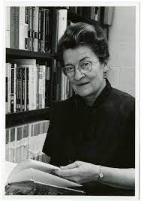
Forms of Attachment
Mary Ainsworth’s Strange Situation paradigm:
  Three phases (~3 minutes each)
    Child and mother first occupy an unfamiliar room filled with toys
    Mother leaves room momentarily
    Mother then returns to room
  Observe child’s reactions during each phase
  Classified four types of attachment
    Three insecure types; one secure

Slide 24
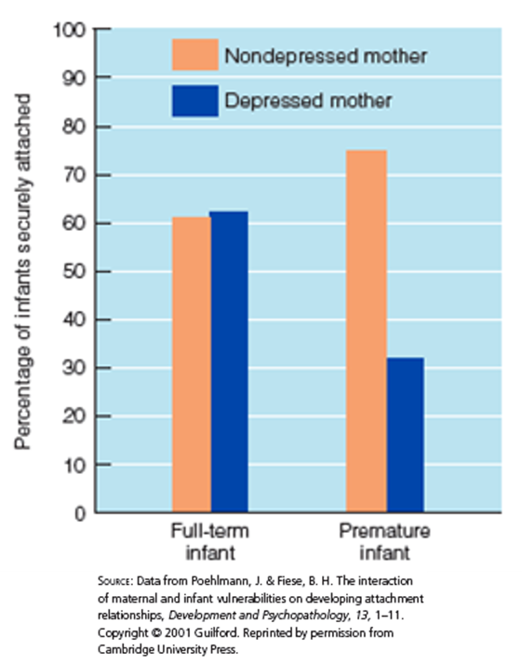

Slide 25
Four Types of Attachment Relationships (1 of 4)
Secure attachment (60–65%):
  baby may or may not cry upon separation; wants to be with mom upon her return and stops crying
  Babies with this attachment type miss their mother but are happy when mother returns
  Understand that everything is okay

Slide 26
Four Types of Attachment Relationships (2 of 4)
Avoidant attachment (20%):
  Baby not upset by separation; ignores or looks away when mom returns
  Type of insecure attachment
  Baby may be used to being left alone

Slide 27
Four Types of Attachment Relationships (3 of 4)
Resistant attachment (10–15%):
  separation upsets baby; remains upset after mom’s return and is difficult to console
  Insecure attachment
  Baby may be angry at mother for leaving them

Slide 28
Four Types of Attachment Relationships (4 of 4)
Disorganized attachment (5–10%):
  separation and return confuse the baby; reacts in contradictory ways (e.g., seeking proximity to the returned mom, but not looking at her)
  Insecure attachment
  Baby seems confused as to why mother left

Slide 29
Quality of Attachment
    Quality of attachment during infancy predicts parent-child relations during childhood, adolescence, and young adulthood
      Securely attached infants depend on their parents for care and support
      Stressful life events are more likely to lead to insecure attachments

Slide 30
Attachment Fears in Infancy
Separation anxiety
  Baby becomes wary or fretful when separated from parent.
  Peaks between 14 and 18 months
Stranger anxiety
  Wary or fretful reaction to the approach of an unfamiliar person
  Peaks around 1 year of age

Slide 31
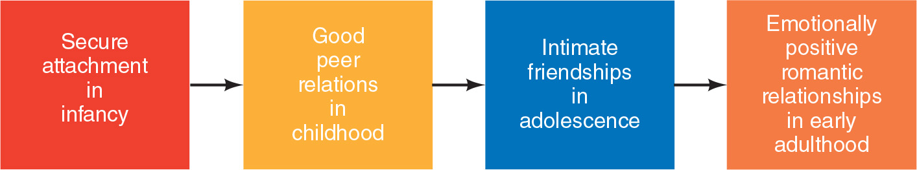
Implications of Early Attachment

Slide 32
Parent–Child Attachments
At age 3
  A child grows more independent of the parent
    Wants separations to be predictable and controllable
Children
  Continue to seek attention and approval from their parents
  Look more to peers for social and emotional support

Slide 33
Parent−Adolescent Attachments
Need the security and encouragement to explore
  Provided by supportive parents
Adolescents with secure parent−child attachments
  Stronger sense of identity
  Higher self-esteem
  Greater social competence
  Better emotional adjustment
  Fewer behavioral problems

Slide 34
Attachment Outcomes in Adulthood
Early caregiving and attachment styles are associated with attachment in adulthood, but are not the sole contributor.
  Secure: close supportive and intimate relationships, well-being and health.
  Insecure: poor emotional regulation, difficulties responding adaptively to stress.
  Insecure avoidant: avoid psychological and emotional intimacy with partners and friends.
  Insecure resistant: evaluate themselves negatively, question self-worth, worry about losing romantic partners.
Notes:
LO 10-5: Examine the development of attachment, its stability, and associated outcomes though the lifespan.
H. Adult Attachment
a. Early caregiving and attachment styles are associated with attachment in adulthood, but are not the sole contributor to adult attachment
b. Secure attachment: associated with close supportive and intimate relationships and predicts well-being and health
b. Insecure attachment: associated with poor emotional regulation and difficulties responding adaptively to stress, which may lead to poor physical and mental health
c. Insecure avoidant attachment: avoid psychological and emotional intimacy with partners and friends, seeking independence, control, and autonomy to maintain a safe emotional distance
d. Insecure resistant attachment: evaluate themselves negatively, question their self-worth, and worry about losing romantic partners

